Slide 1

Systematic consideration of federal Open Science Infrastructure
Towards understanding agency OSI prioritization using data from grants.gov

Slide 2
What we want to know? Broad questions about federal engagement with open science
What sorts of Open Science endeavors are there?
What exists?
Where does it exist?
Which topics are being funded?
What topics / endeavors have been funded?
How much support and over what time period?
Looking at interactions of agencies and the gestalt
How do agency approaches relate?
What areas require prioritization?
We can use grants.gov to explore this.

Slide 3
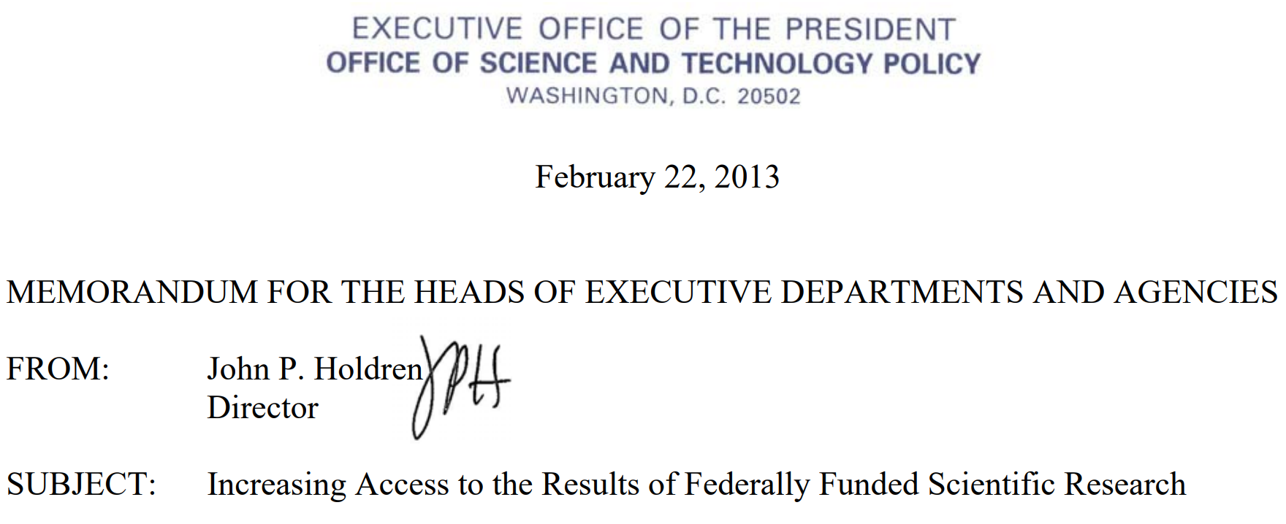
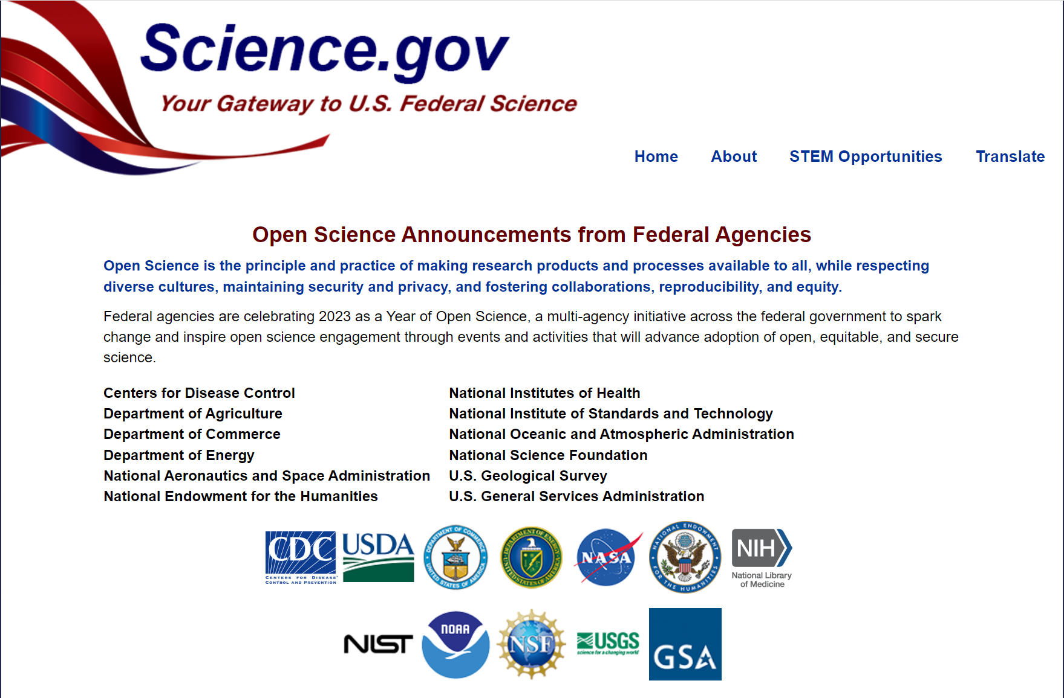
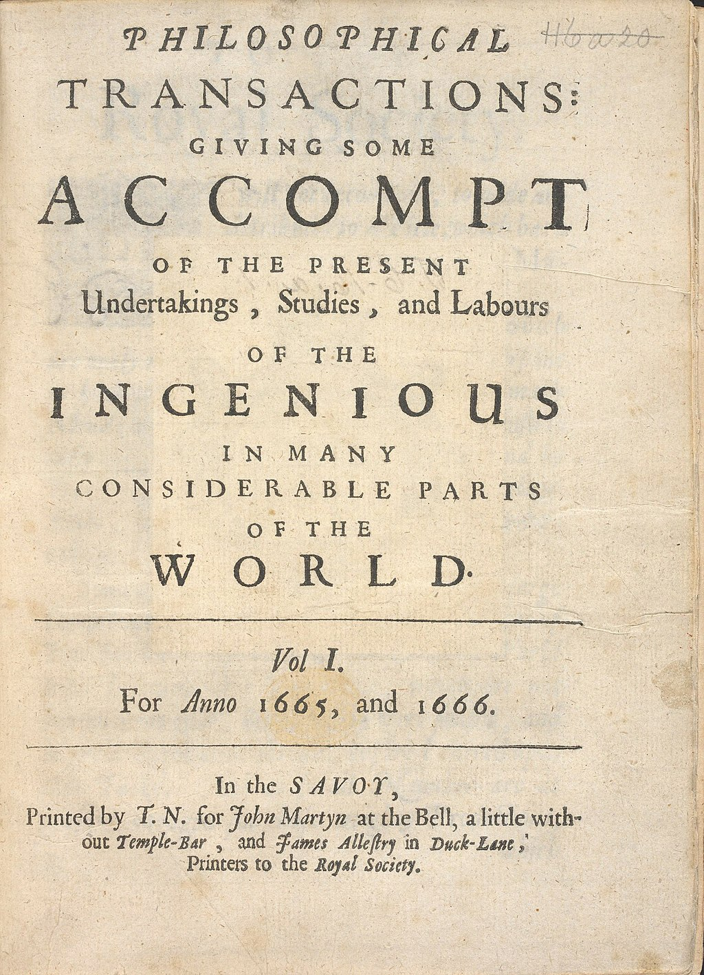

Open Science: a new focus …but not a new concept

Slide 4
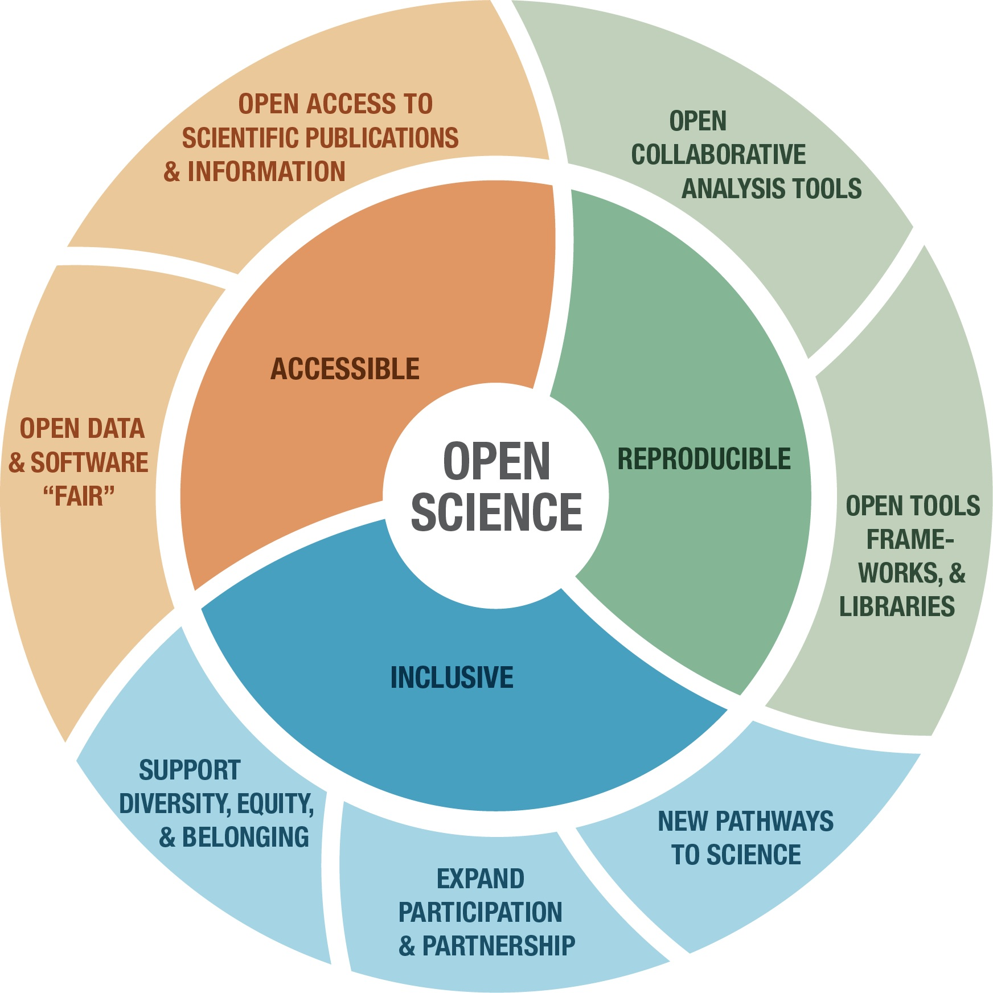
How have federal agencies fostered open science? And how can we learn about such efforts?
?

Slide 5

Targeted case studies Single cases, dialogue-oriented

Slide 6
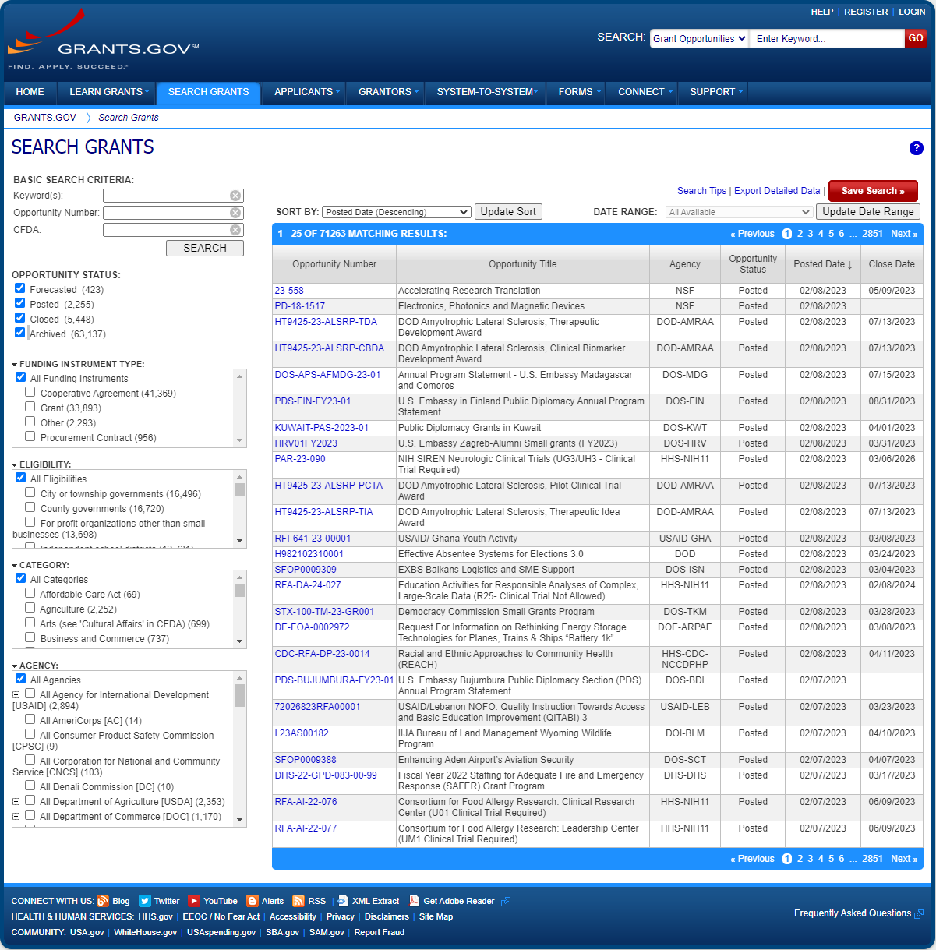
Grant program funding as mission pursuit Tracking priorities & foci with existing data

Slide 7
Knowing what to know
Given the resources of grants.gov, what would we like to know about government funding of open science infrastructure?
~70,000 grants recorded
Stretches back to ~2011
Includes brief descriptions of grants.
Also includes, agency, date, funding amount, and some other details.
Primary challenge: how do we know which grant programs are relevant to open science infrastructure?

Slide 8
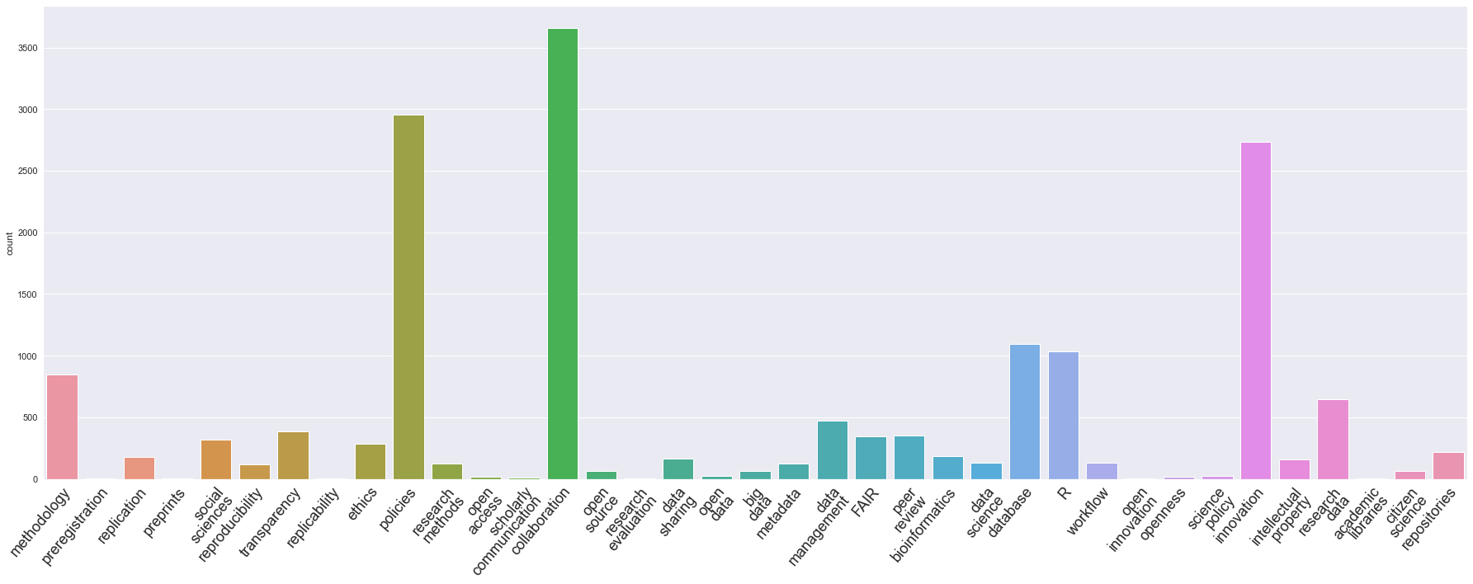
Some initial insights from grants.gov Open Science keywords found in grant program descriptions
Open science keywords taken from Lee & Chung (2022)
Not all terms found
Some generic terms over-represented
Sizable number of detections, overall

Slide 9
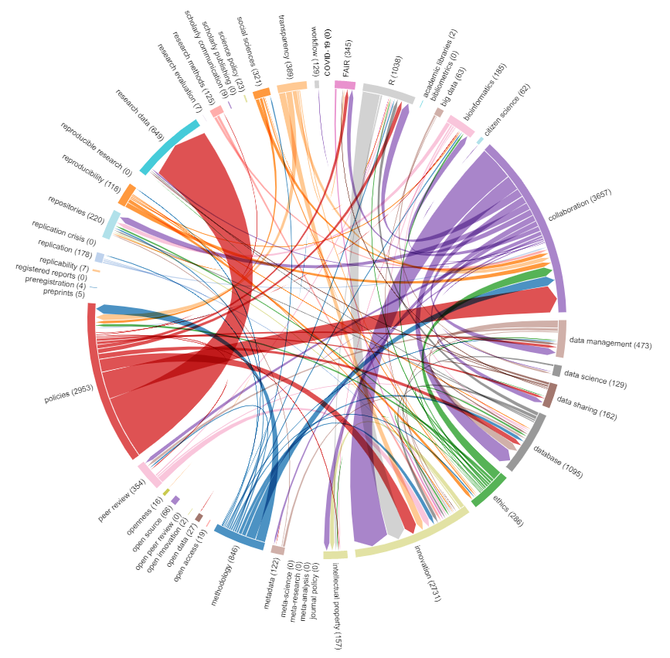
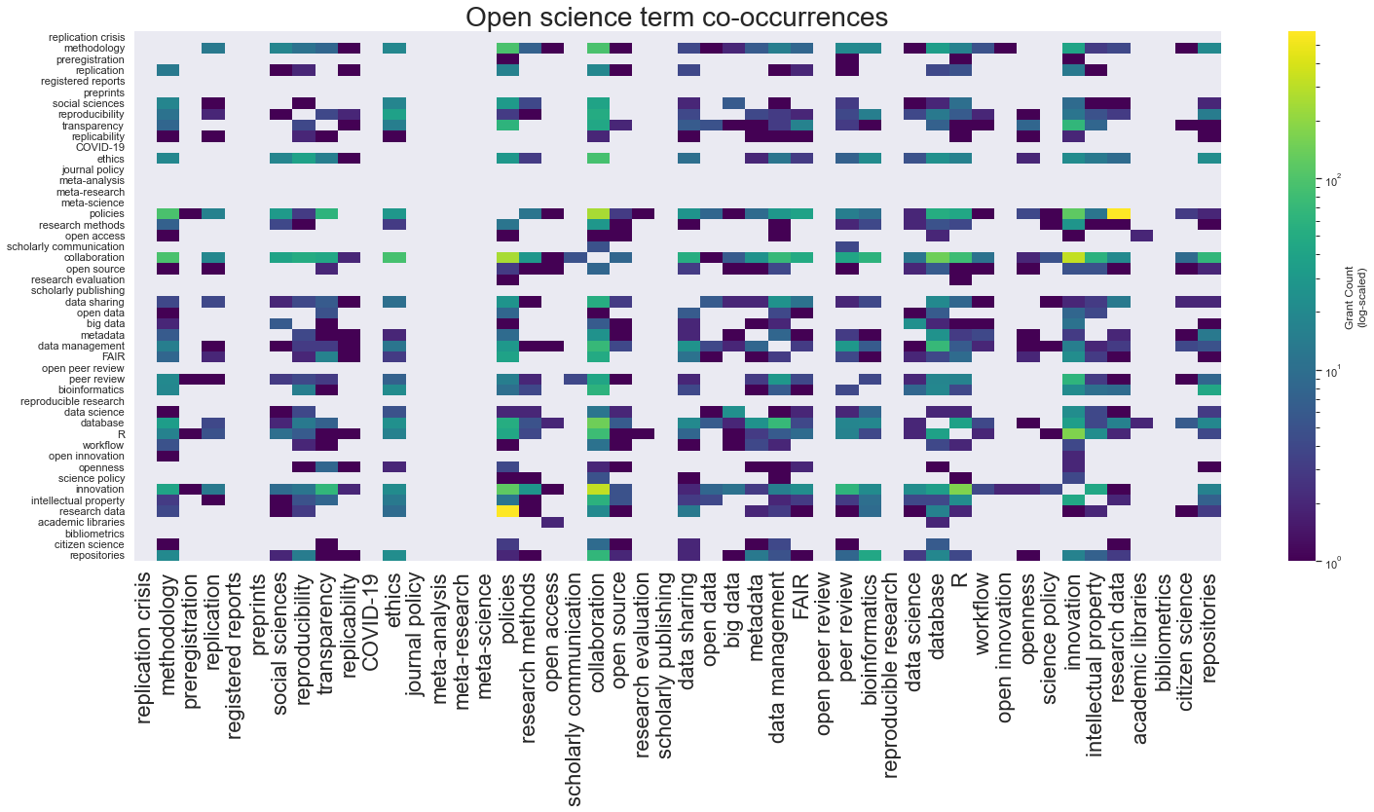
Some initial insights from grants.gov Co-occurrence of open science keywords
Moderately sparse
Low co-occurrence may indicate usage unrelated to open science
Potential follow-up analyses

Slide 10
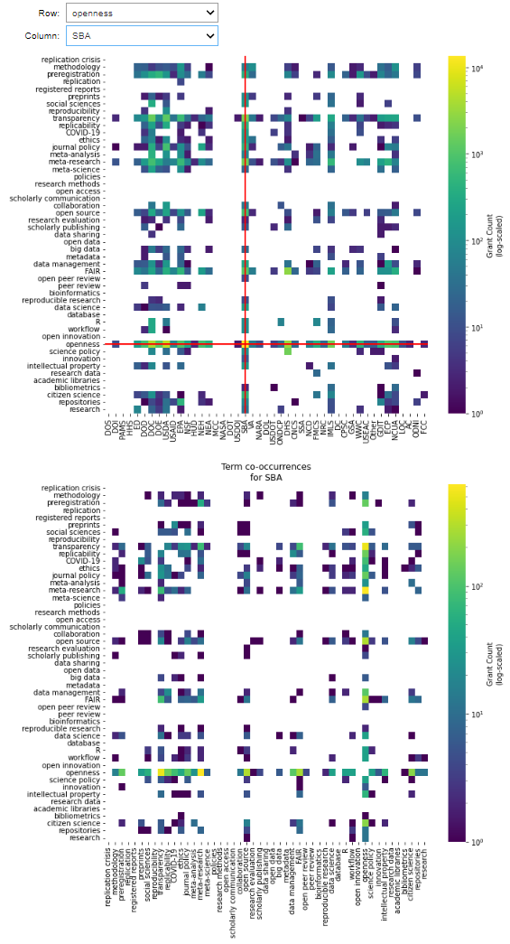
Some initial insights from grants.gov Co-occurrence of open science keywords—within specific agencies
Interactive figures available
Within-agency co-occurrence patterns
Ability to take closer looks at specific contexts

Slide 11
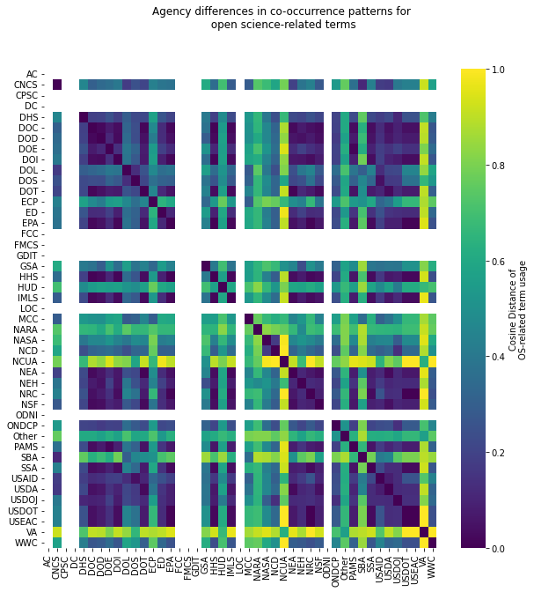
Some initial insights from grants.gov Cross-agency comparisons of keyword usage
Highly similar usage patterns correspond to blue shading.
Highly dissimilar usage patterns correspond to yellow shading.
Consistently related “blue block” suggests multi-agency group with coherent usage*.
Potential for modularity / module-based analysis
* = keyword, rather than semantically based.

Slide 12
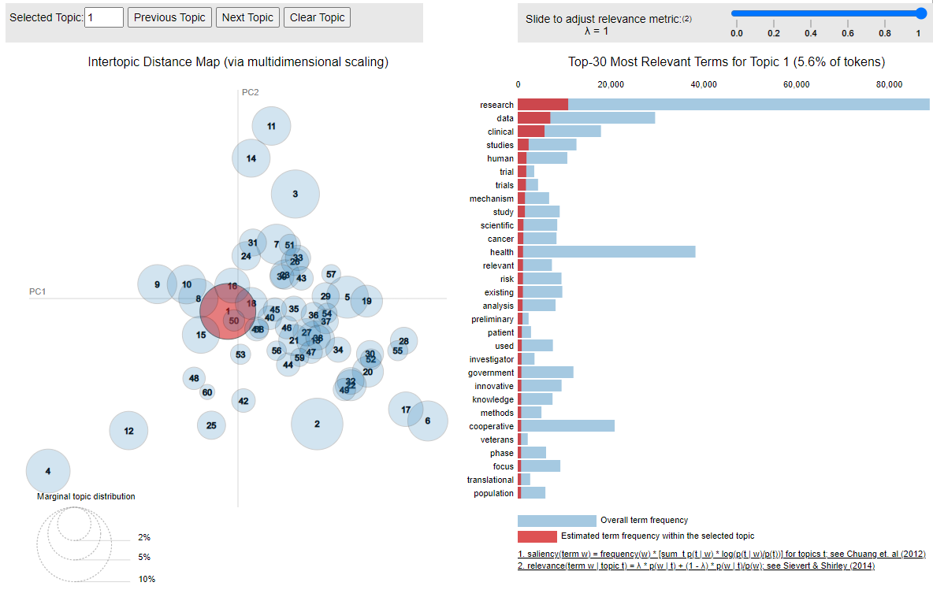
Some initial insights from grants.gov Topic modeling using Latent Dirichlet Allocation (LDA)
Clusters documents based on similarity of words used*
Requires development and application of stop-word lists
Subject to parameter choices
* = all words, after stop-word removal, but still not semantically based.

Slide 13
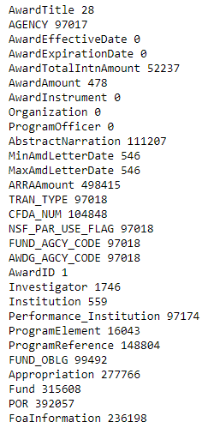
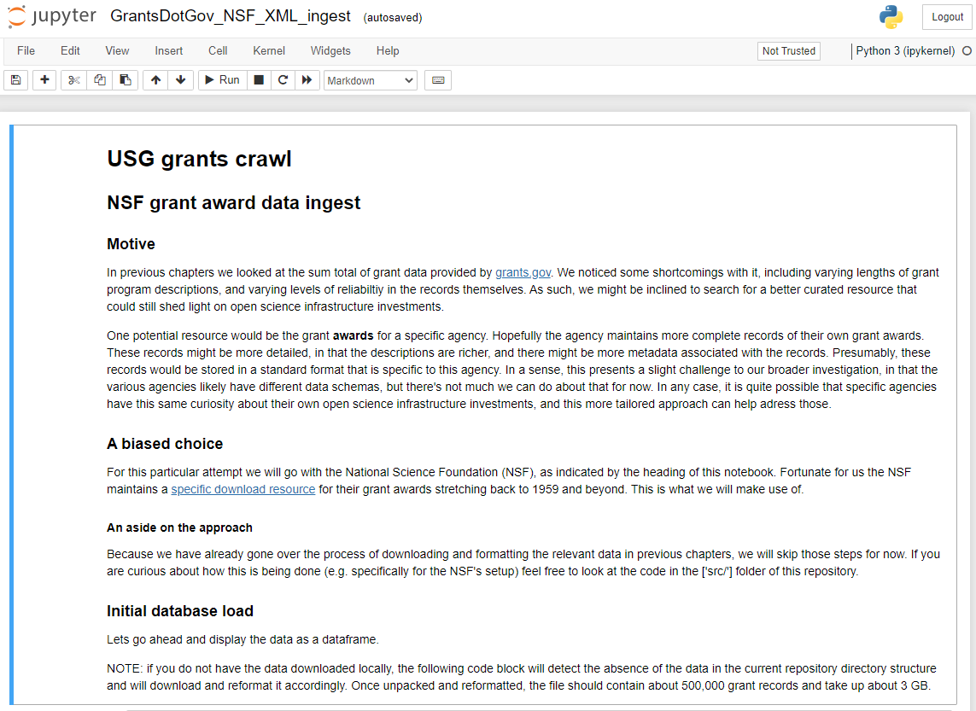
Some initial insights from NSF awards Re-application of methods to agency-specific award data
[Field-wise count of null values]

Slide 14
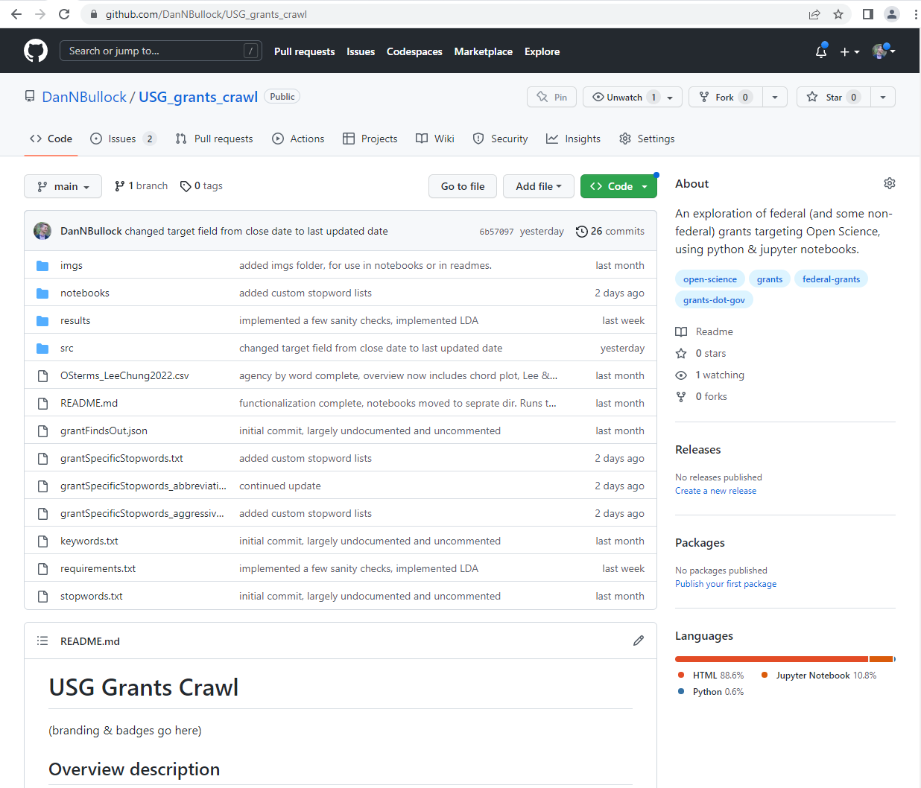
Current state of investigation resource Where is this and in what state does it exist?
Currently situated as an open repository on GitHub
Comprised of standard project structure elements
Content and process documented across Jupiter notebooks.
Interactive visuals available.

Slide 15
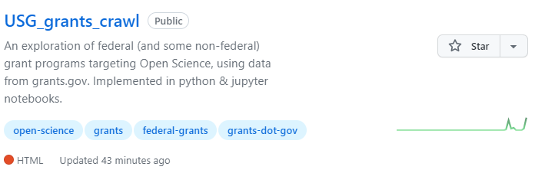
Future steps Towards more advanced analyses
LLM embeddings (hardware / resource dependent)
Agency-specific analyses / aglomeration
Synthetic data sets (automatedly generated grant description simulations)
Detecting reliably related collections of terms (see Lee & Chung (2022) for example)

Slide 16
New questions & directions?
Given the grants.gov data source,
what questions would you like to ask?

Slide 17
Preemptive Questions and Answers
Why use grant solicitations rather than (successful) grant proposals?
Grants.gov serves as a single point of access for grant data, with a moderately standardized format.
Successful grant award data is likely stored in agency specific repositories in agency specific formats.
It’s publicly and openly available (i.e., no restricted access)
In the event that there was a desire to augment this analysis with grant proposal/award text, the methods could be extended to that application.
See NSF-specific notebooks for an example of this implementation.
How reliable / complete / clean is the data from grants.gov
Moderate, on most accounts. See corpus slide for word-count distribution. Short & absent descriptions moderately common.
This also highlights the importance of agencies ensuring high-quality record entry.
The cleaner / more reliable a data set is, the more reusable and valuable it is.
Have you considered looking at funding trends over time?
Yes, however, within-keyword consideration of such trends suffers from low sampling issues
Is it possible to use a separate set of keywords?
Most certainly, and we welcome efforts to develop a keyword list that is more focused on the sub-committee’s interests.
I noticed some spelling errors in the repository, what’s that about?
The markdown editor I am using does not have a spell check feature. I encourage the submission of issues or fixes using the GitHub interface!

Slide 18
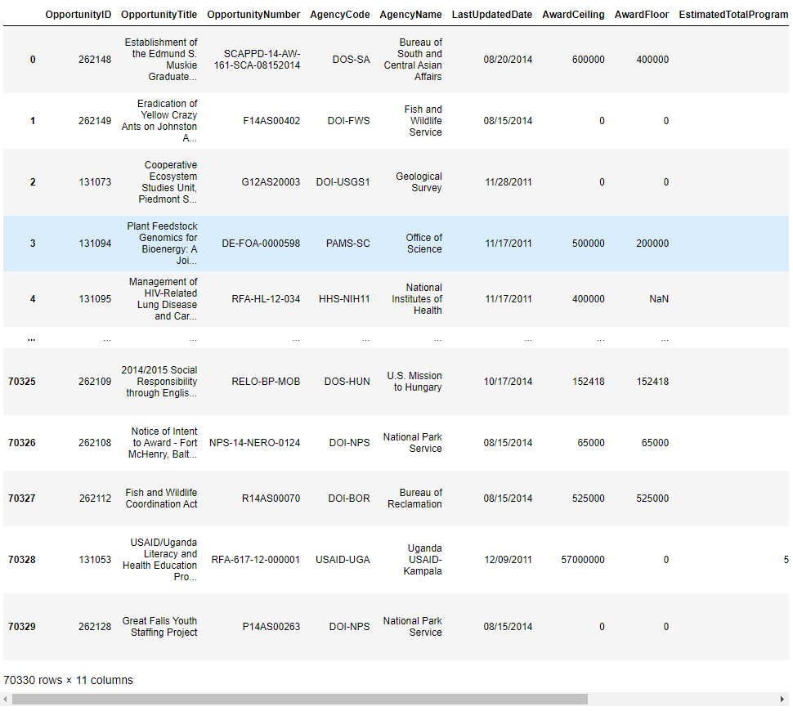
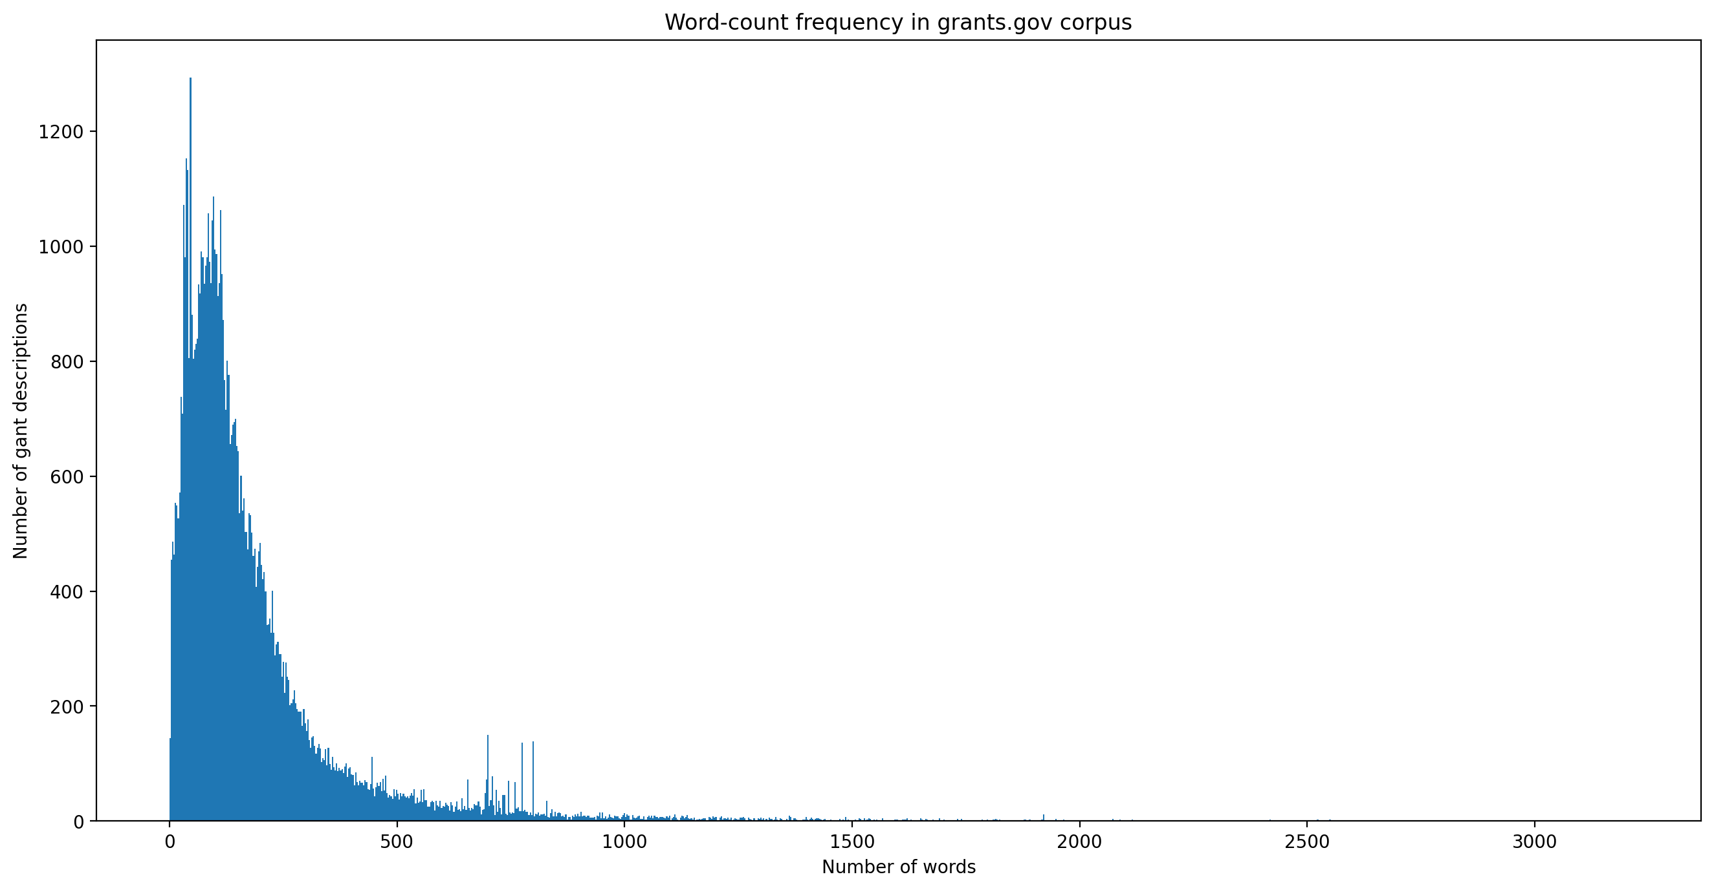
What’s in the corpus?

Slide 19
Example grant description text What does the corpus actually contain?
the geosciences open science ecosystem (geo ose) program seeks to support sustainable and networked open science activities to foster an ecosystem of inclusive access to data, physical collections, software, advanced computing, and other resources toward advancing research and education in the geosciences. the purpose of this support is to broadly enable geoscientists to leverage expanding information resources and computing capabilities to address interdisciplinary grand challenge research questions at the forefront of the geosciences. priority goals for geo ose are to: (i) improve the openness and scientific value of the existing network of cyberinfrastructure resources in the geosciences and related fields, such as data repositories, opensource software communities, and shared computing resources (e.g., high-performance and cloud computing), including via alignment on and adoption of common data and metadata standards that advance access and interoperability; (ii) democratize access to cyberinfrastructure capabilities that enable innovative geosciences research and education, including by advancing cloud based approaches and workflows; (iii) strengthen the capacity of current and future geoscientists to access, utilize, and collaborate within the growing ecosystem of open science resources; and (iv) contribute to advancing open science principles within the geosciences, including (but not limited to) the fair guiding principles for scientific data management and stewardship (findable, accessible, interoperable, reusable), the care principles for indigenous data governance (collective benefit, authority to control, responsibility, and ethics), and the trust principles for digital repositories (transparency, responsibility, user focus, sustainability, and technology), as well as reproducibility and replicability.
the idea development award is intended to support new ideas that represent innovative approaches to prostate cancer research and have the potential to make an important contribution to the pcrp mission. the key components of this award mechanism are: innovation: research deemed innovative may represent a new paradigm, challenge current paradigms, look at existing problems from new perspectives, leverage unique study populations, or exhibit other highly creative qualities. research that is an incremental advance upon published data is not considered innovative. multidisciplinary projects are especially encouraged. impact: applications are required to address and provide a solution to one or more of the fy19 pcrp overarching challenges. the potential impact of the research, both shortterm and longterm, in addressing the fy19 pcrp overarching challenge(s) should be clearly described. highimpact research will, if successful, significantly advance prostate cancer research and/or patient care. preliminary data: due to this award’s emphasis on innovation, the presentation of preliminary data relevant to prostate cancer and the proposed project is encouraged, but not required. any unpublished, preliminary data provided should originate from the laboratory of the principal investigator (pi) or a member(s) of the research team. regardless whether preliminary data is included or not, applications should be based on a sound scientific rationale that is established through logical reasoning and/or critical review and analysis of the literature. to maximize the potential for impact, investigators are strongly encouraged to incorporate the following components into their study design where appropriate: authentication of proposed cell lines; statistical rigor of preclinical animal experiments and epidemiological studies; incorporation of experiments to assess clinical relevance and translatability of findings; and validation in patient cohorts. as such, the pcrpfunded prostate cancer biorepository network (pcbn) (http://www.prostatebiorepository.org) and/or the north carolina – louisiana prostate cancer project (pcap) (https://pcap.bioinf.unc.edu) are important resources to consider if retrospectively collected human anatomical substances or correlated clinical data are critical to the proposed studies. studies utilizing data derived from large patient studies that…

Slide 20
Example grant description text What does the corpus actually contain? (continued)
the purpose of this funding opportunity announcement (foa) is to promote research that transforms understanding of hiv transmission, the hiv care continuum, and hiv comorbidities using big data science (bds). these approaches should include projects to assemble big data sources, conduct robust and reproducible analyses, and create meaningful visualization of big data.
the purpose of the administrative supplement is to provide support for nihfunded investigators to prepare and deposit individuallevel data from cancer epidemiology studies into nih/ncisupported, controlledaccess databases including the cancer epidemiology data repository (cedr) and the database of genotypes and phenotypes (dbgap). sharing of **research data** will accelerate scientific discovery and increase opportunities for collaboration to provide new clues to cancer etiology, determine risk factors, and improve cancer survivorship.
this funding opportunity announcement (foa) invites applications that propose to foster data sharing and wider use of longitudinal data for research on aging in the behavioral and social sciences. it encourages applications for a cooperative agreement to promote data archiving, dissemination, and consultation with producers and users of data resources for research on aging.
the graduate research innovation (grin) award is for current master and doctoral students enrolled at colleges or universities within the united states in the field of wildland fire and related physical, biological, and social sciences, to enhance student exposure to the management and policy relevance of their research to achieve beneficial outcomes of funded work.
this ra solicits groundbreaking singleinvestigator proposals from junior faculty for research and development in the areas of physical sciences, engineering, mathematics, medicine, biology, information and social sciences of interest to darpa’s defense sciences office (dso), microsystems technology office (mto), and information innovation office (i2o). see attached darpara1212. see attached modification 2 to darpara1212.

